Slide 1
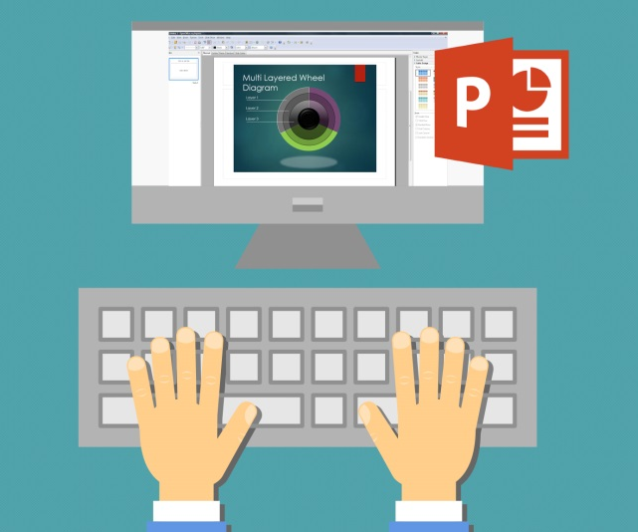

Customized Shapes and Maps - Bonus

Slide 2
Customized Shapes

Slide 3
Customized Shapes – Moons and Traffic Lights

Slide 4
Customized Shapes – Venn Diagram
Text
Text
Text
Text
Text
Text
Text
Text
Text
Text
Text

Slide 5
Customized Shapes – Puzzle and Circular Arrows

Slide 6













Flags
Icons
Arrows

Slide 7
Customized Shapes - Timelines

Slide 8
Maps

Slide 9
Maps - Africa

Slide 10
Maps - Asia

Slide 11
Maps - Australia

Slide 12
Maps – EU Countries

Slide 13
Maps – USA

Slide 14
Maps – UK and Ireland

Slide 15
Maps – Map of the World

